Slide 1


PREDICTIVE MAINTAINANCE FOR AIRCRAFT ANALYSIS
TEAM-05

Slide 2
Team Members
S Sreehar : Team leader, Data Analyst
Avinash Reddy Polireddy : ML Engineer, App Development
Anusha katapally : Data Modeling
Sai Deepak Devadari : Storytelling and Data Visualization
https://github.com/Sreehar-99/PREDICTIVE-MAINTAINANCE-FOR-AIRCRAFT-ANALYSIS_Final-Project

Slide 3
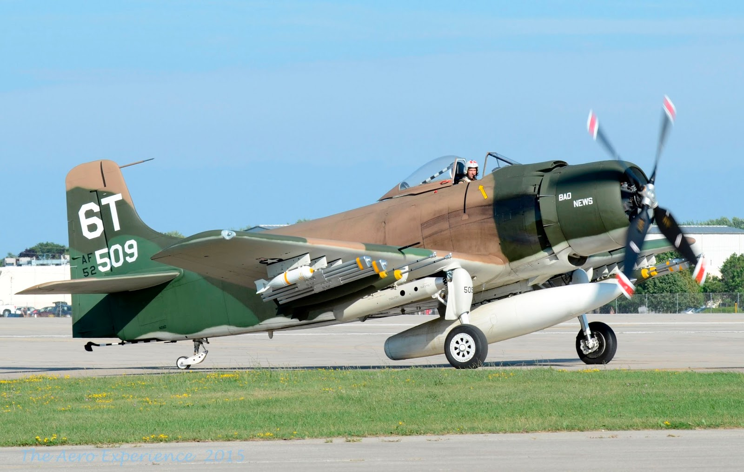
Introduction
We addresses the challenge of predicting engine failure within a specific cycle, leveraging historical cycles and sensory data. By harnessing the power of machine learning, this project seeks to enhance aircraft engine maintenance, ensuring passenger safety, reducing operational costs, and preventing unnecessary maintenance.

Slide 4
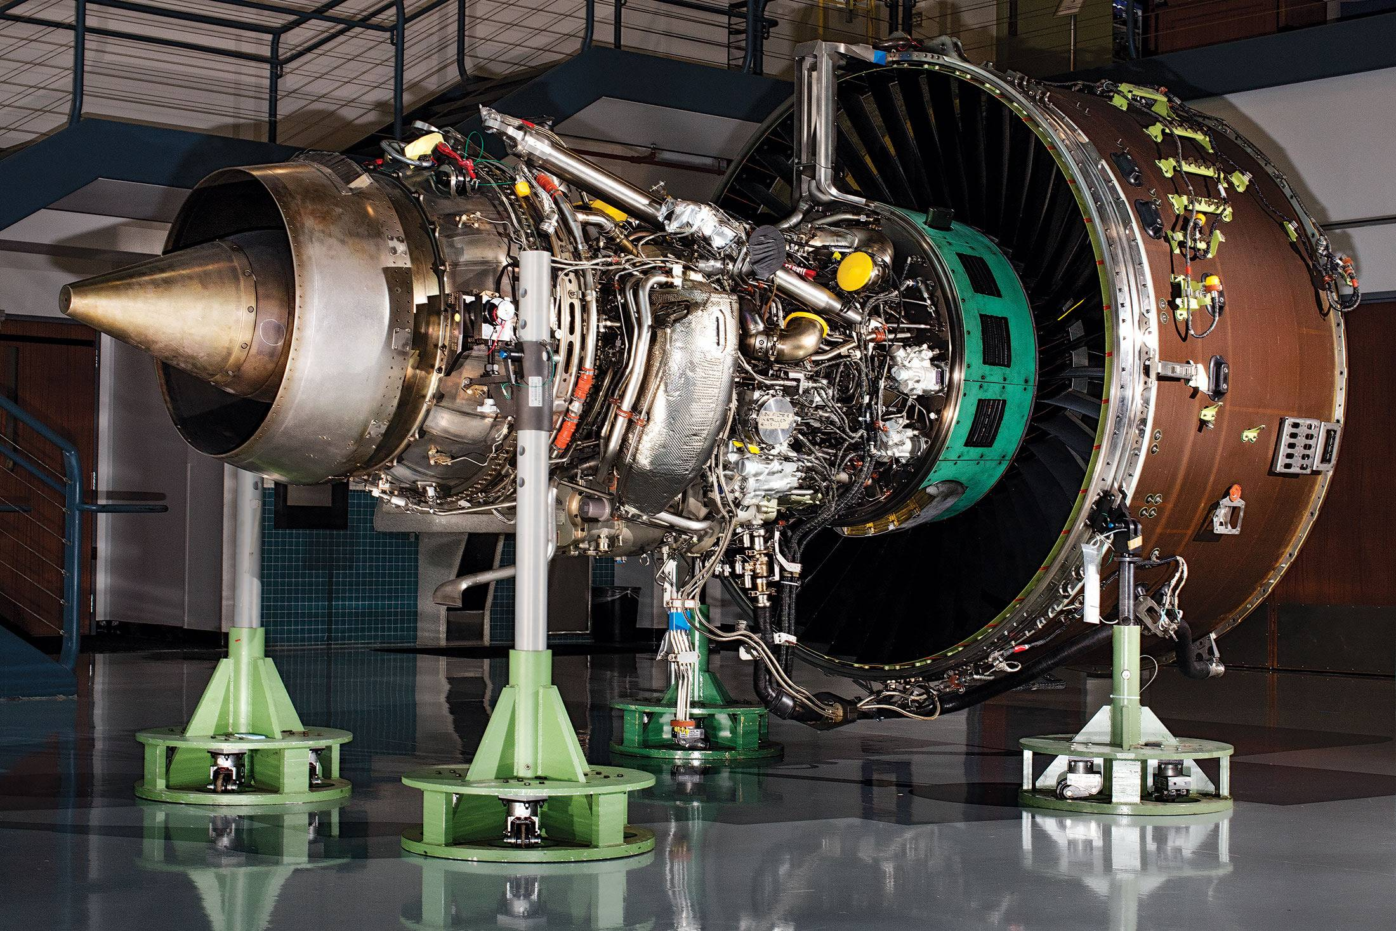
Objective:
The primary objective of the Predictive Maintenance for Aircraft Analysis project is to predict whether an aircraft engine will fail within a given cycle, leveraging historical cycles and sensory data. By employing machine learning algorithms, this project aims to:
Enhance aircraft safety by accurately predicting engine failure.
Reduce operational costs by optimizing maintenance schedules.
Prevent unnecessary maintenance, thereby avoiding undue financial burdens.

Slide 5


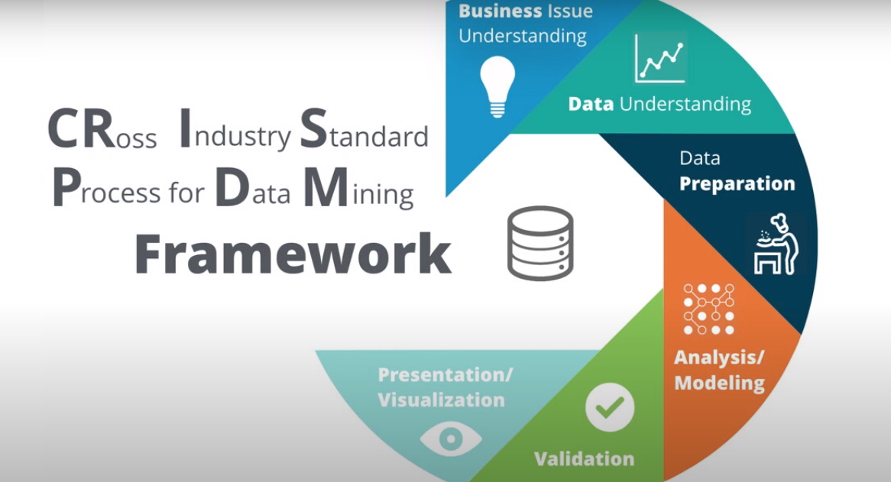


Tools or Technologies
Utilizing tools such as: ETL: Apache NiFi or Airflow for data integration.
Amazon Web Services (AWS): AWS EC2 instances will be used for model development and execution.
CRISP-DM: Use Jupyter notebooks for each stage of the methodology.
Data Visualization: Matplotlib for visualizing model outputs.
App Development: Implement a web or mobile app using Flask.

Slide 6
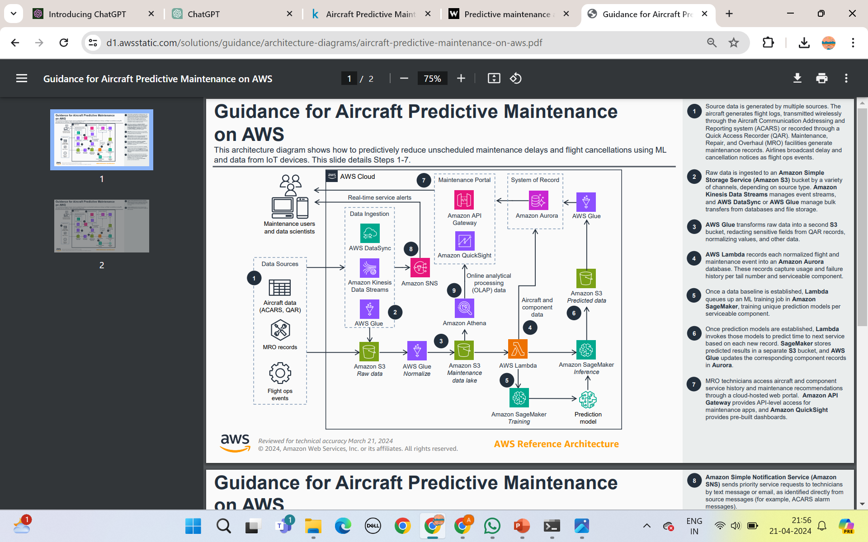

Slide 7
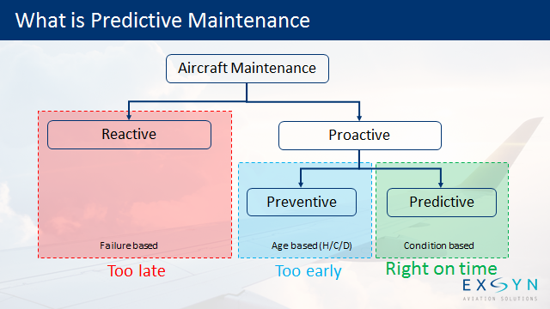

Slide 8
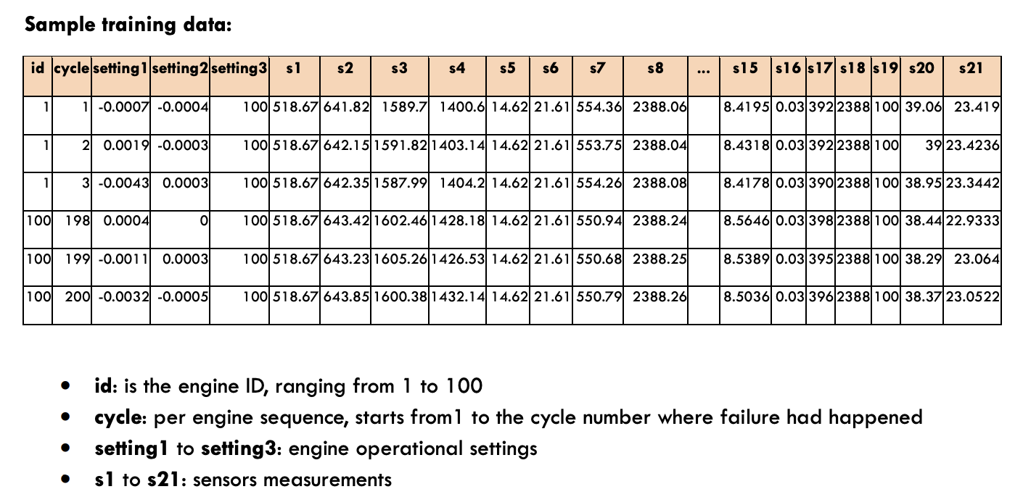

Slide 9
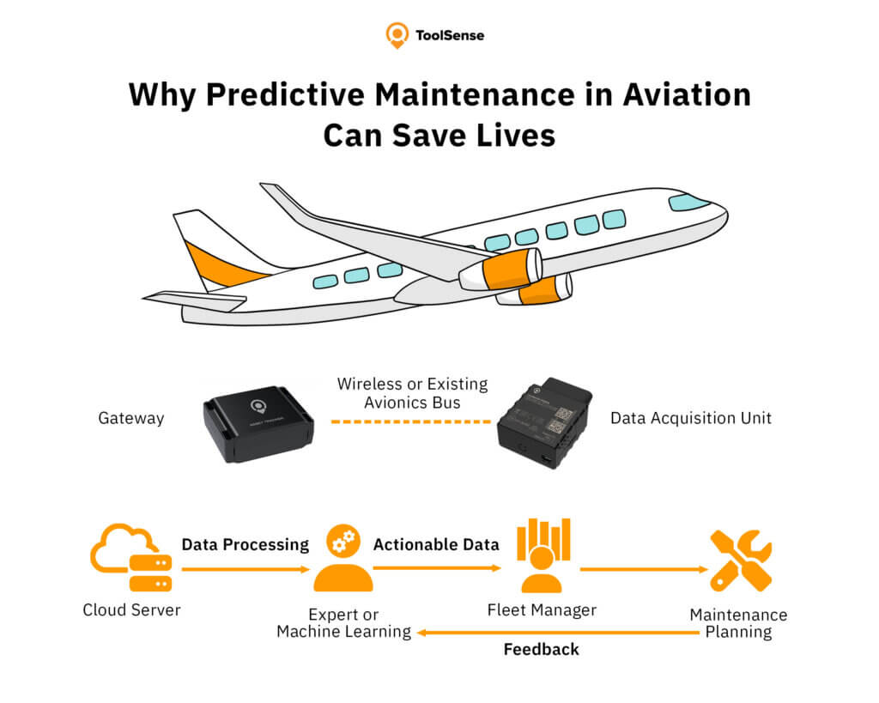
Why predictive maintenance in aviation can save lives
9

Slide 10
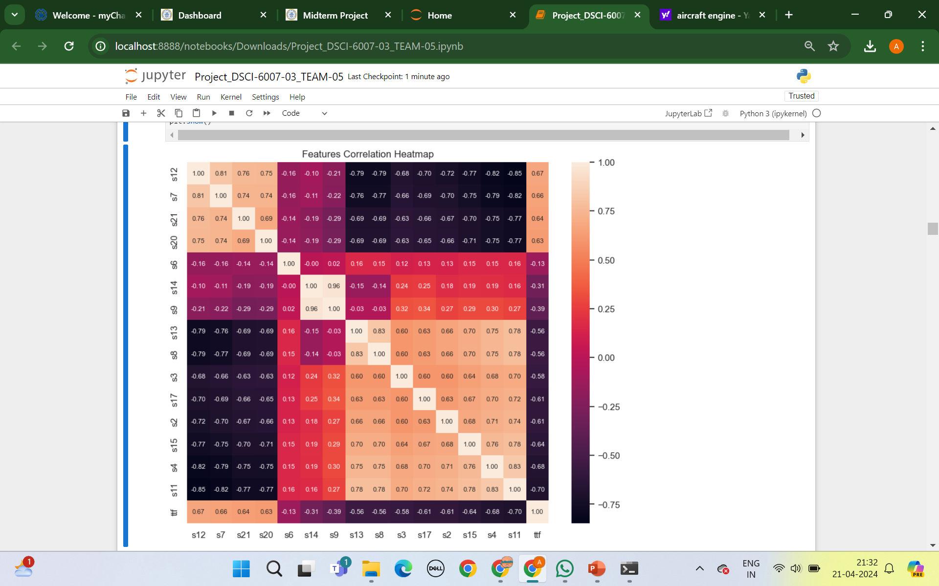

Slide 11
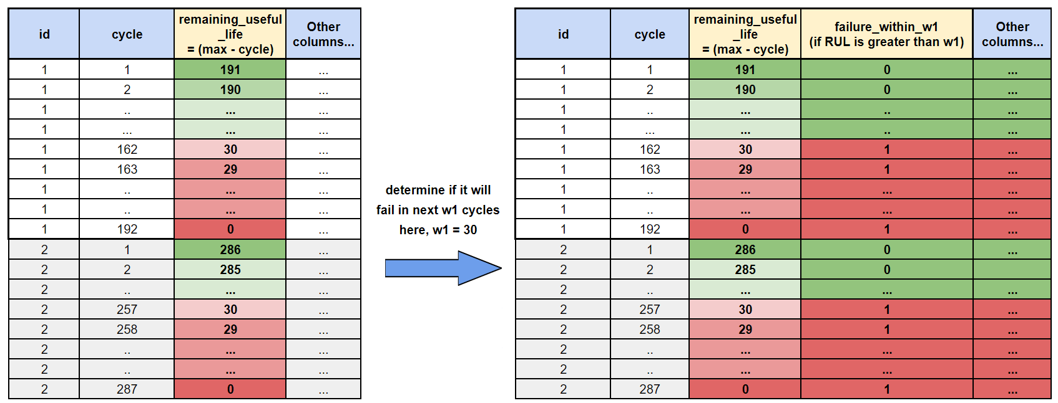

Slide 12
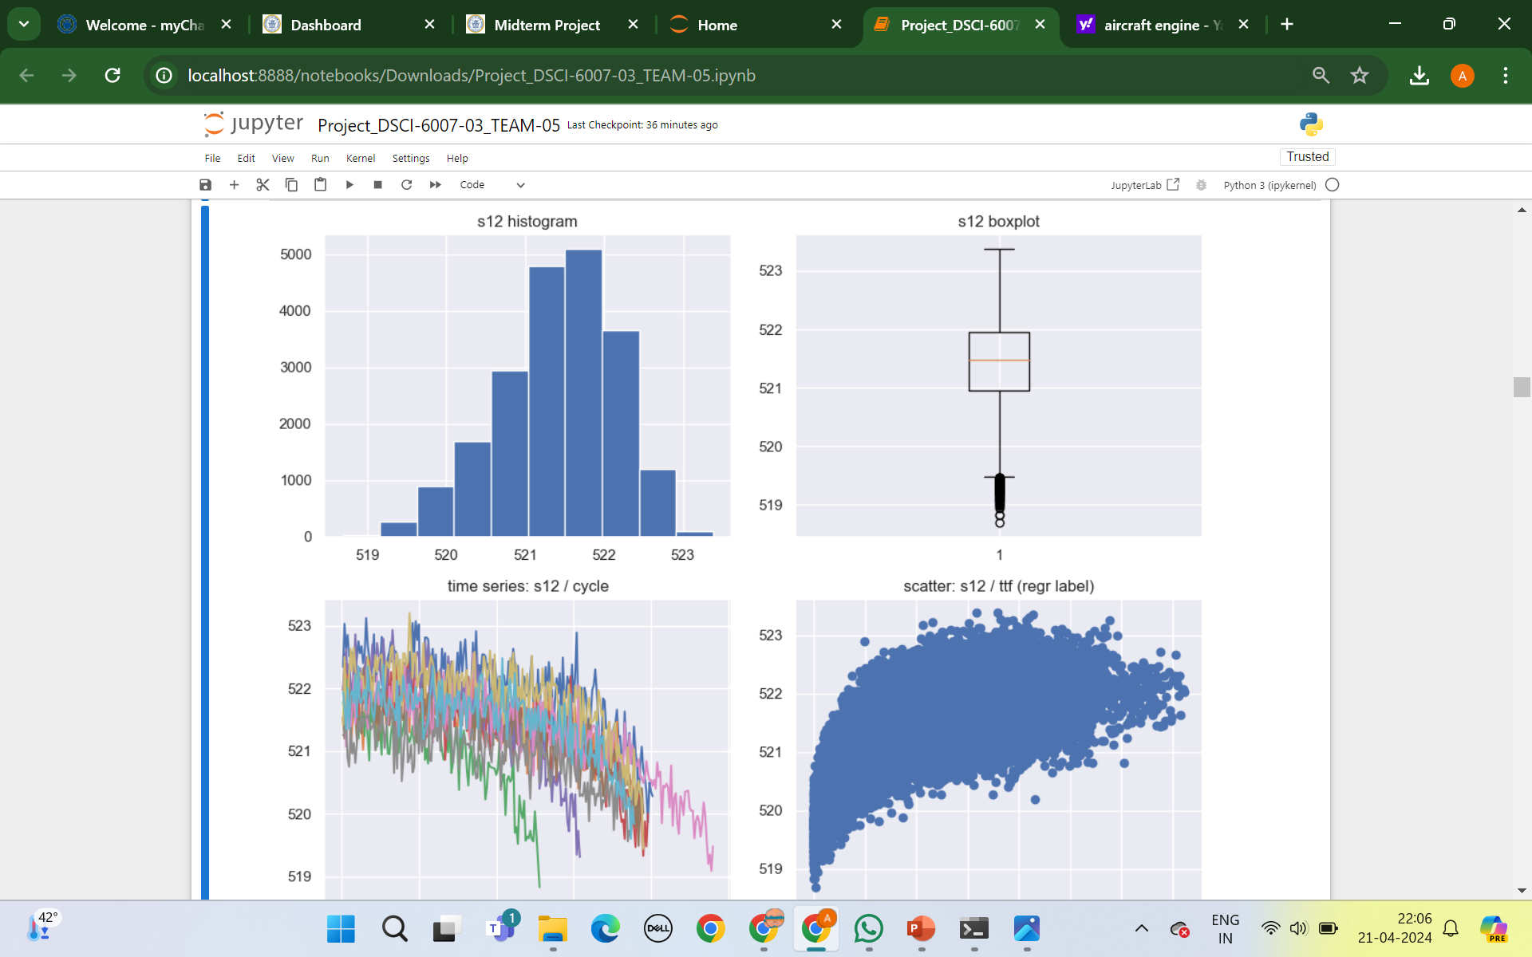
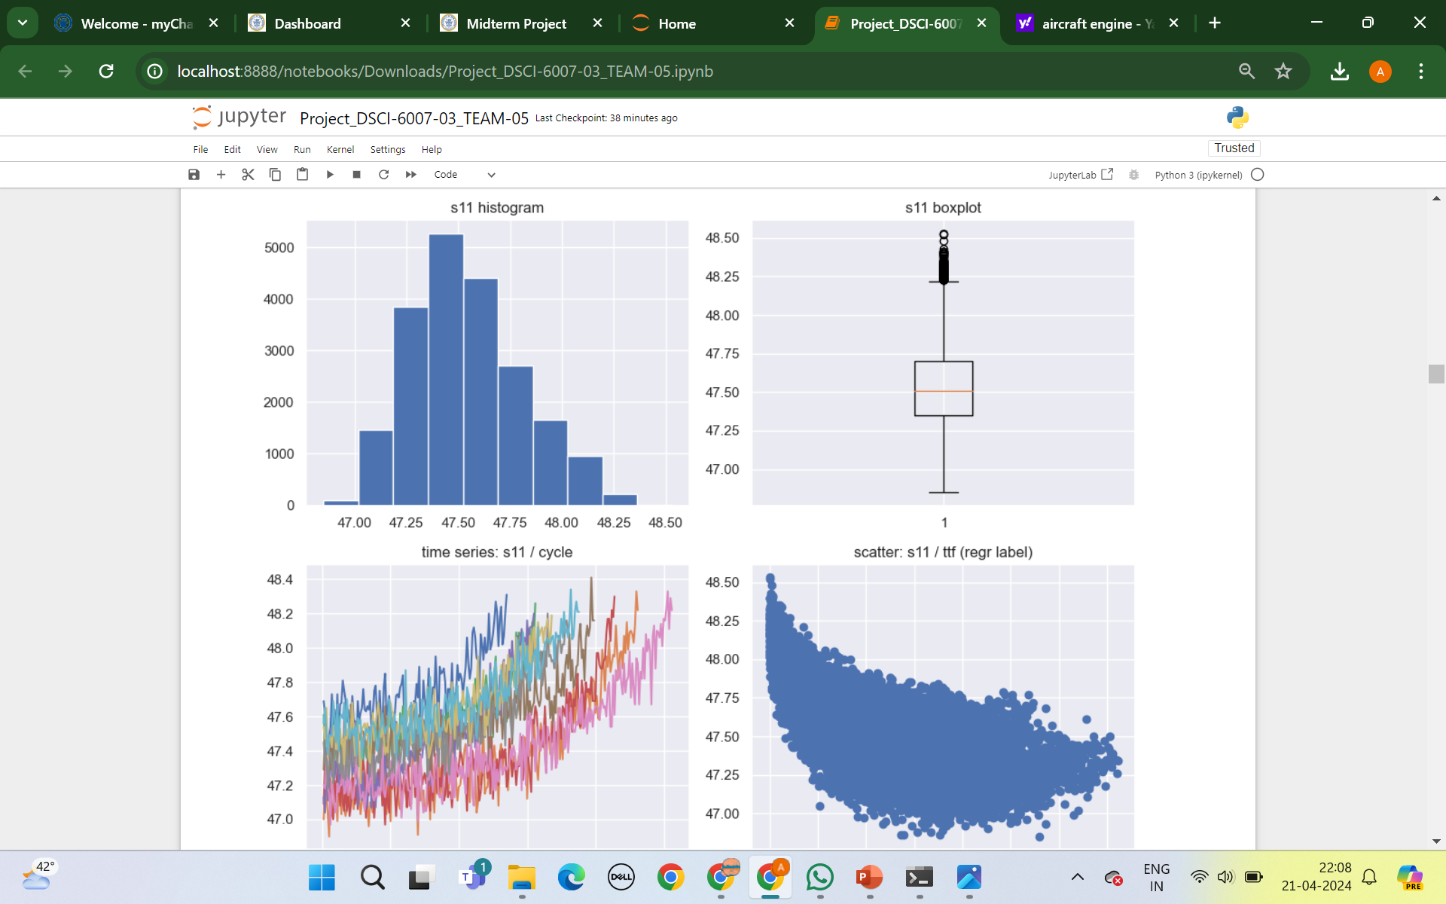

Slide 13
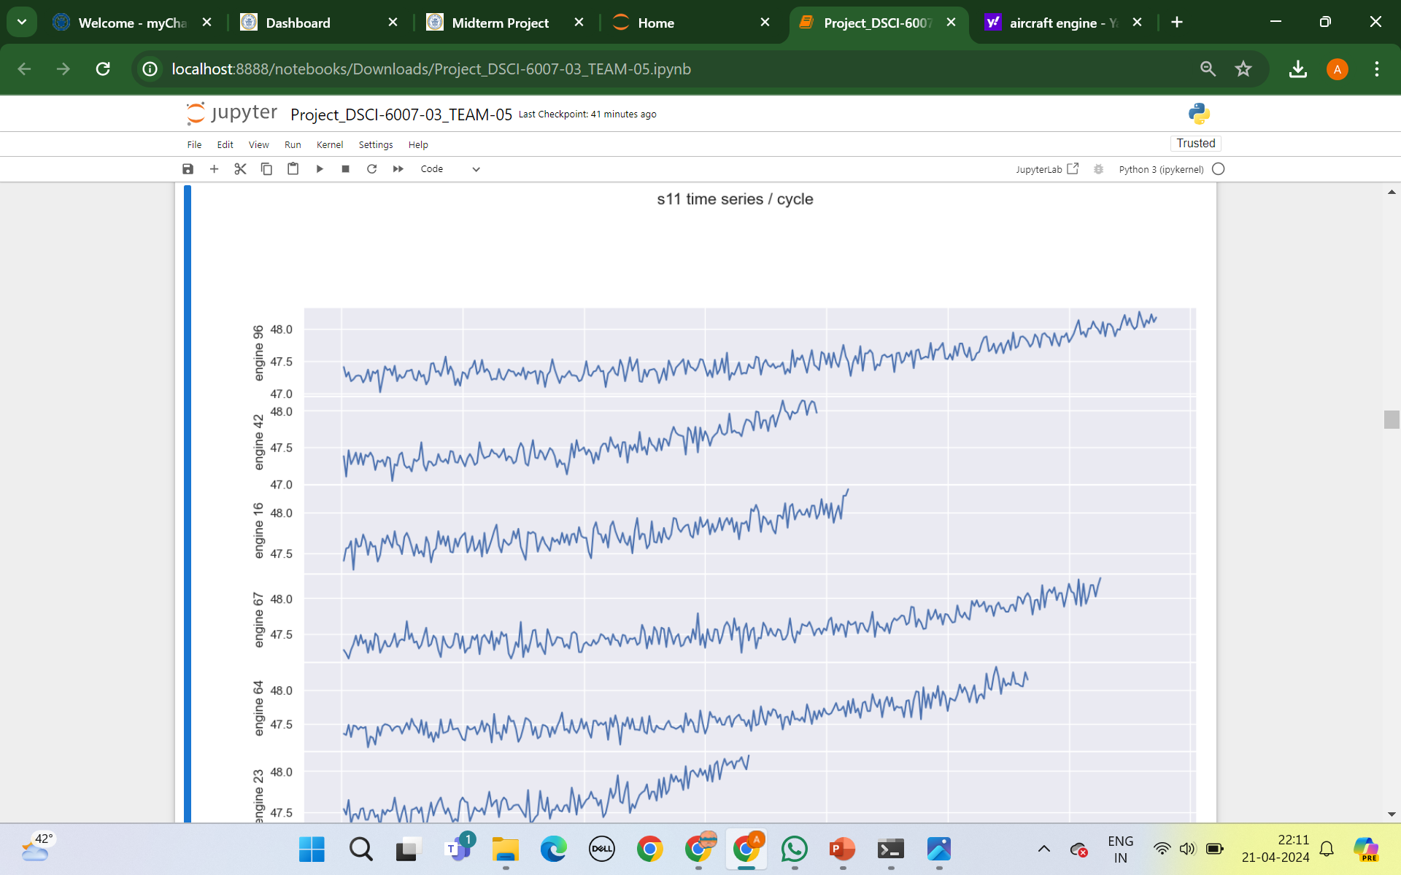
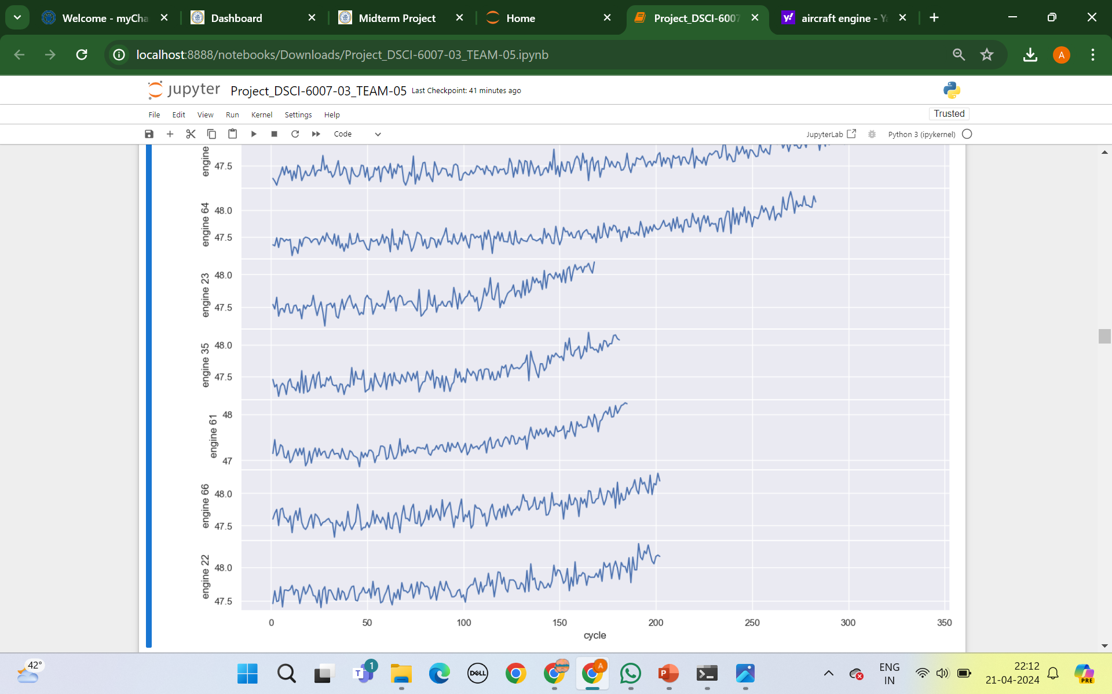

Slide 14
CONCLUSION
In conclusion, The Predictive Maintenance for Aircraft Analysis project aims to develop accurate predictive models to enhance aircraft safety, reduce operational costs, and prevent unnecessary maintenance. By leveraging machine learning techniques, the project will revolutionize aircraft engine maintenance, ensuring the highest levels of safety and operational efficiency while minimizing costs.

Slide 15
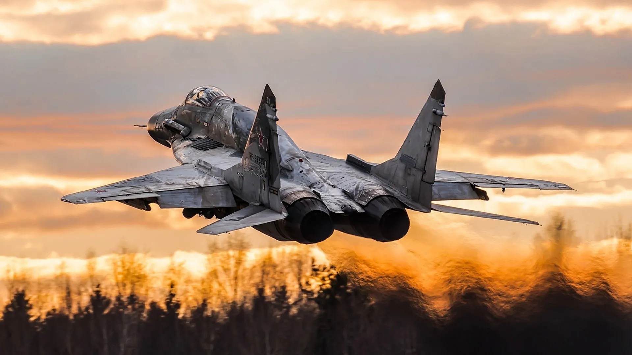
Thank you

